Slide 1
Lecture 13
Machine Learning 4

Slide 2
Overview
1 Recap
2 Model Selection for Clutering
3 Artificial Neural Networks
4 Generative Pre-trained Transformer (GPT)

Slide 3
Part 1: Recap
Notes:
This lecture will begin with a recap on regression and how to find a model class.

Slide 4
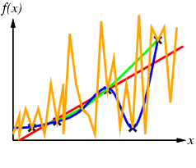
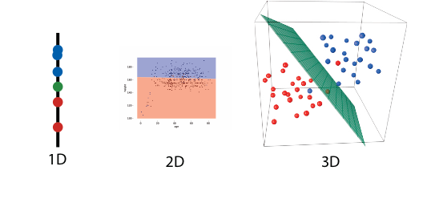
Recap
Choosing the right model class
For classification
For regression
Separation
Consistence
Notes:
Last week we discussed choosing the right model class for classification and regression. For classification, recall that the number of features we choose will the change the dimension in which we are modeling. For example, given a single feature of “size” to determine whether they belong to the price>100 class or price<100 class, we can model this on a line where every instance with an size above 25 has an price>100. We try to find a model that separates the classes.
For regression we may choose different lines to model our data, looking for one that is consistent with the data.
Recall that a model too ‘simple’ for the data means it is underfitted and a model too complex and customised to the training data is overfitted.

Slide 5
Part 2.3: Model selection for Clustering
Notes:
Now we will look at an unsupervised method.

Slide 6
Clustering
1 | 0
3 | 1
2 | 0
4 | 0
3 | 0
2 | 1
6 | 1
3 | 0
No labels!
5 | 0 | ?
MODEL
(clustering)
LEARNER
No descriptive label!
< instance
Cluster id = 3
feature
feature
Notes:
In unsupervised learning tasks, like clustering, there are no labels on the training data. This means that we have values for the features we want to use but there is no ‘class’ or ‘label’ that we know to be correct that is given to the model. The features go through a learner to the model, which then predicts which cluster a new example belongs to.

Slide 7
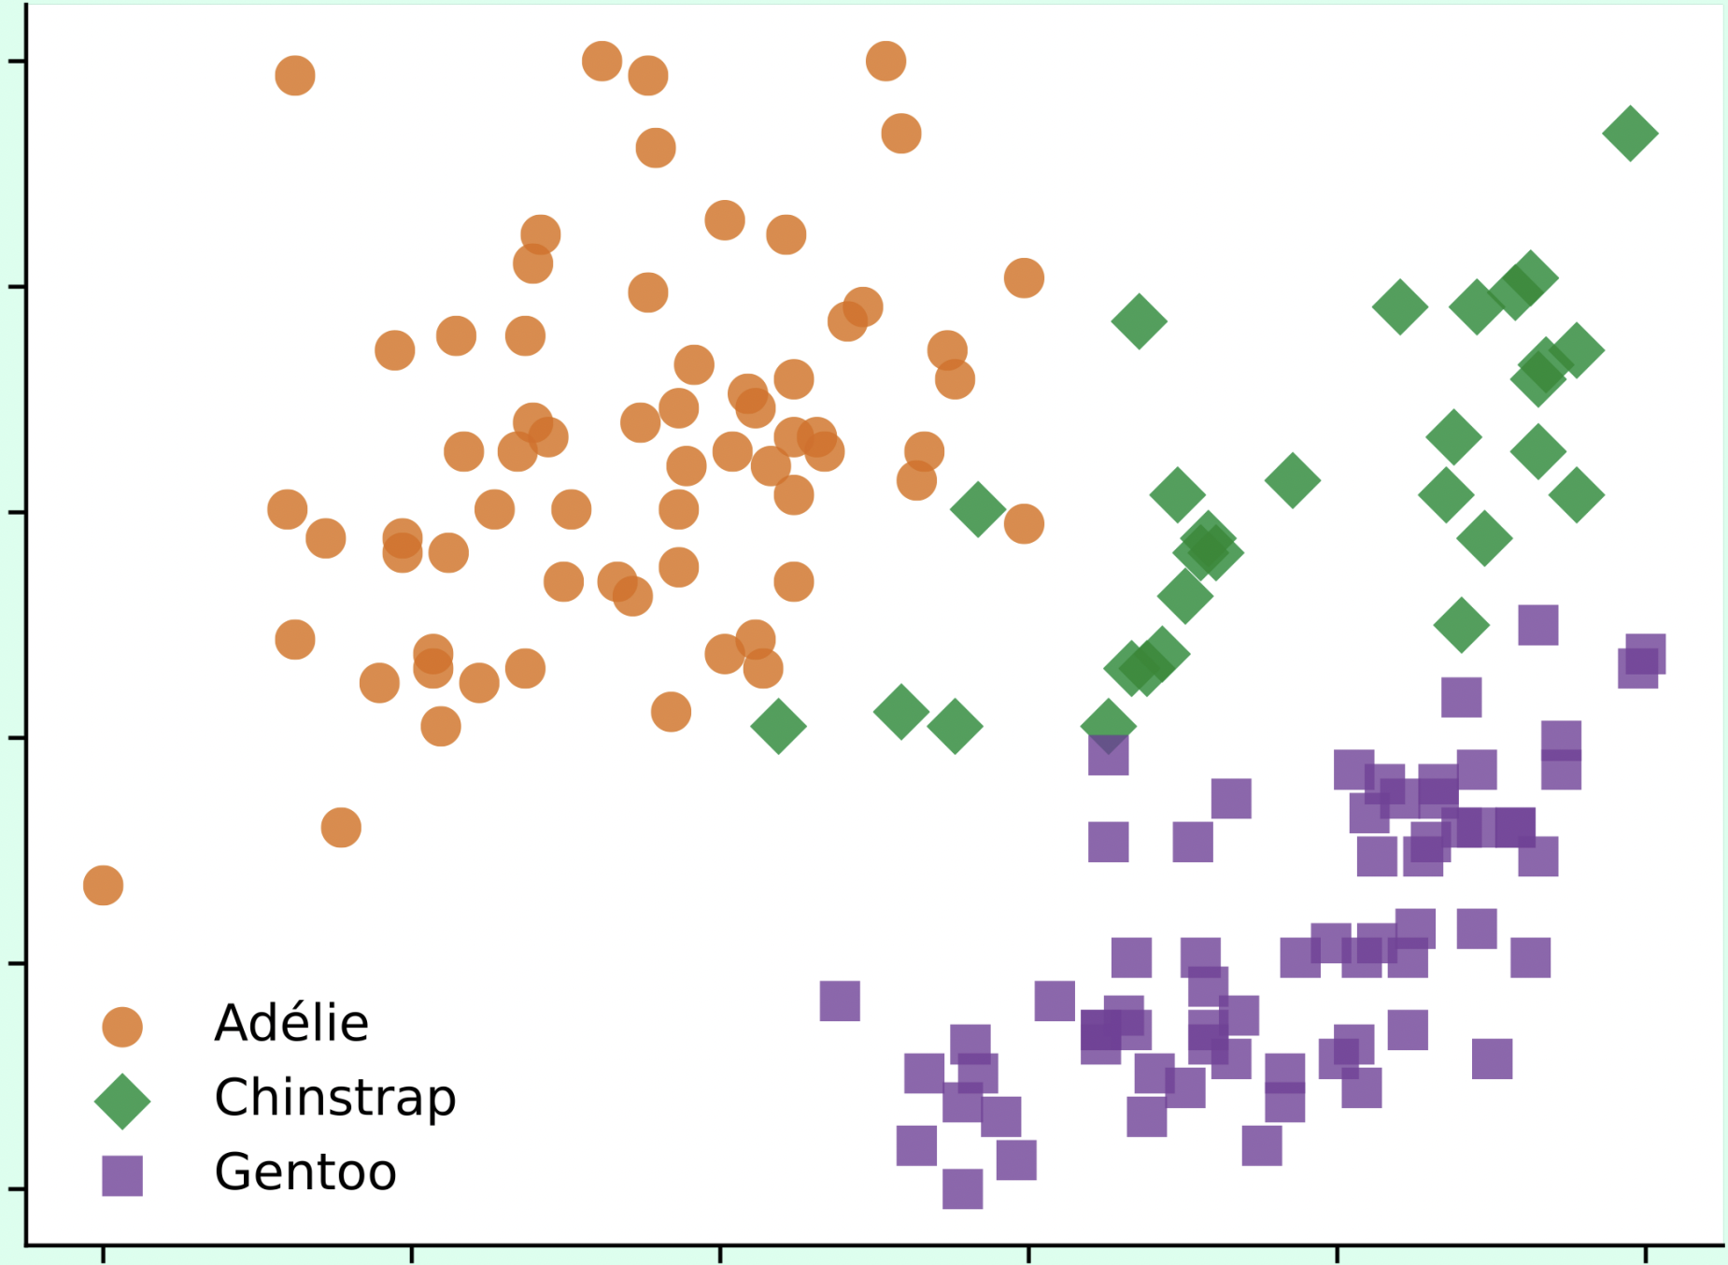
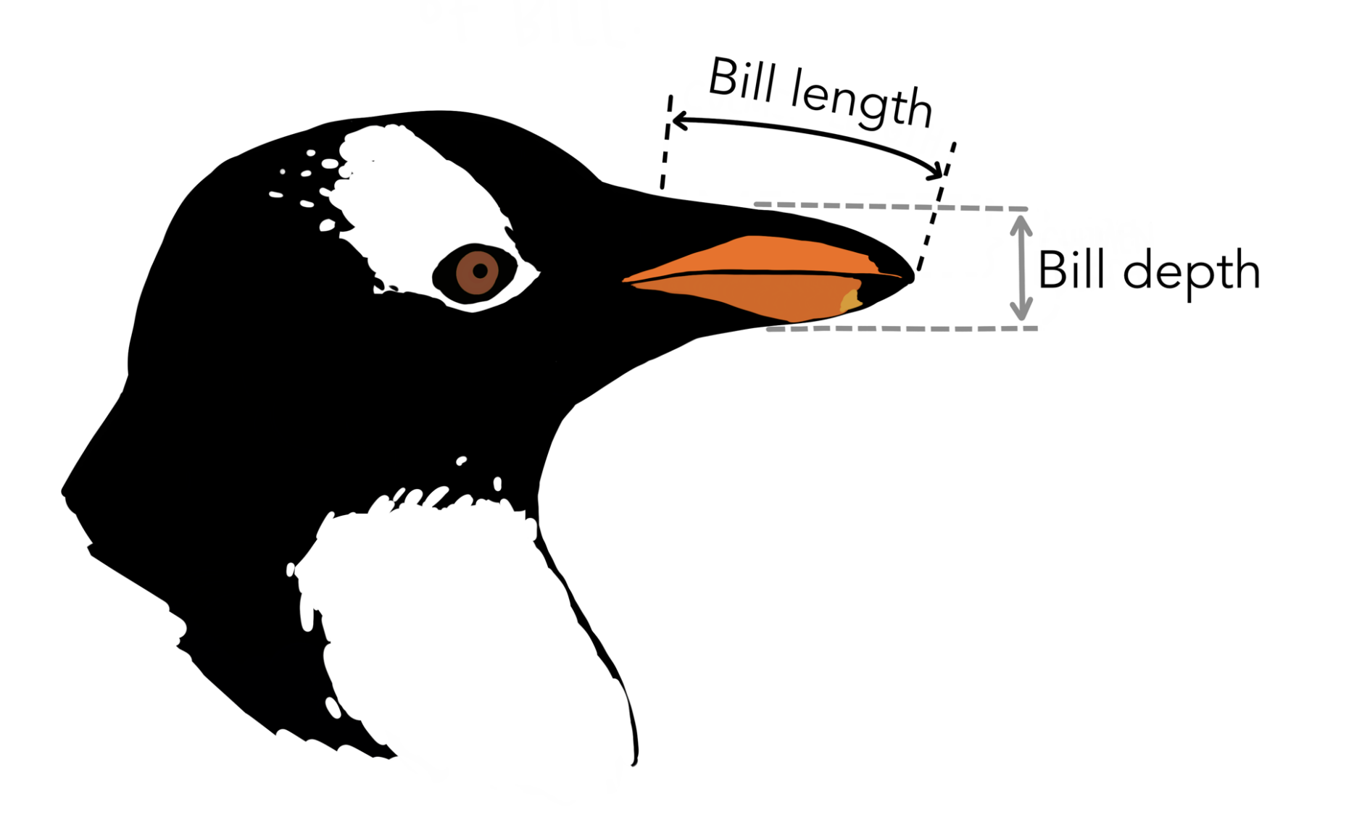
Clustering Example
Bill depth (mm)
Bill length (mm)
Notes:
Given the bill length and depth of a collection of penguins, we can cluster the penguins into different types.
image source: https://allisonhorst.github.io/palmerpenguins/

Slide 8
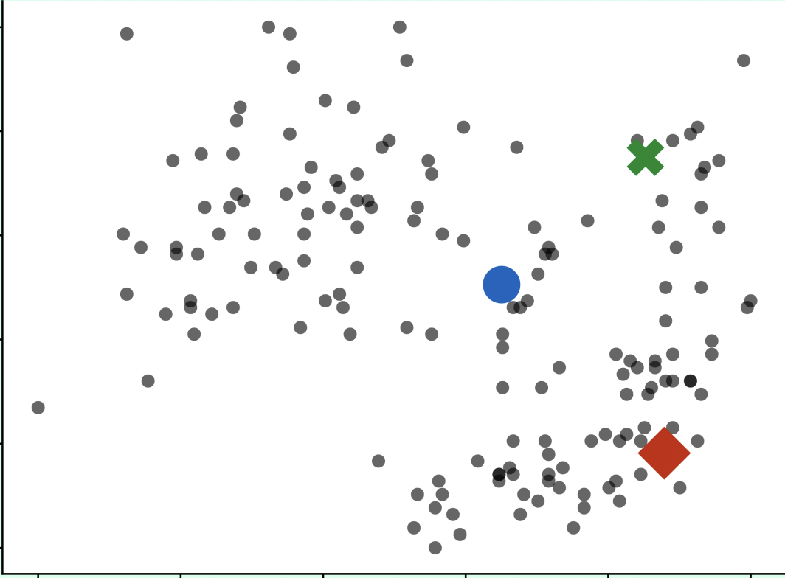
K-means Example with k = 3
Choose random seeds as means, in this case k = 3.
What is k? An input parameter estimated by the user.
In practice: evaluate results of different k values and choose best performing k.
Notes:
K-means is the simplest algorithm for clustering. The first step for the user or engineer is to choose a k value, which is the number of clusters we are interested in. In this case we know that there are 3 types of penguins in this collection so k = 3. If the user does not know how many clusters is ideal, the user should try the model with different k values and evaluate their performance.
K random data points are chosen to be the first seeds.

Slide 9
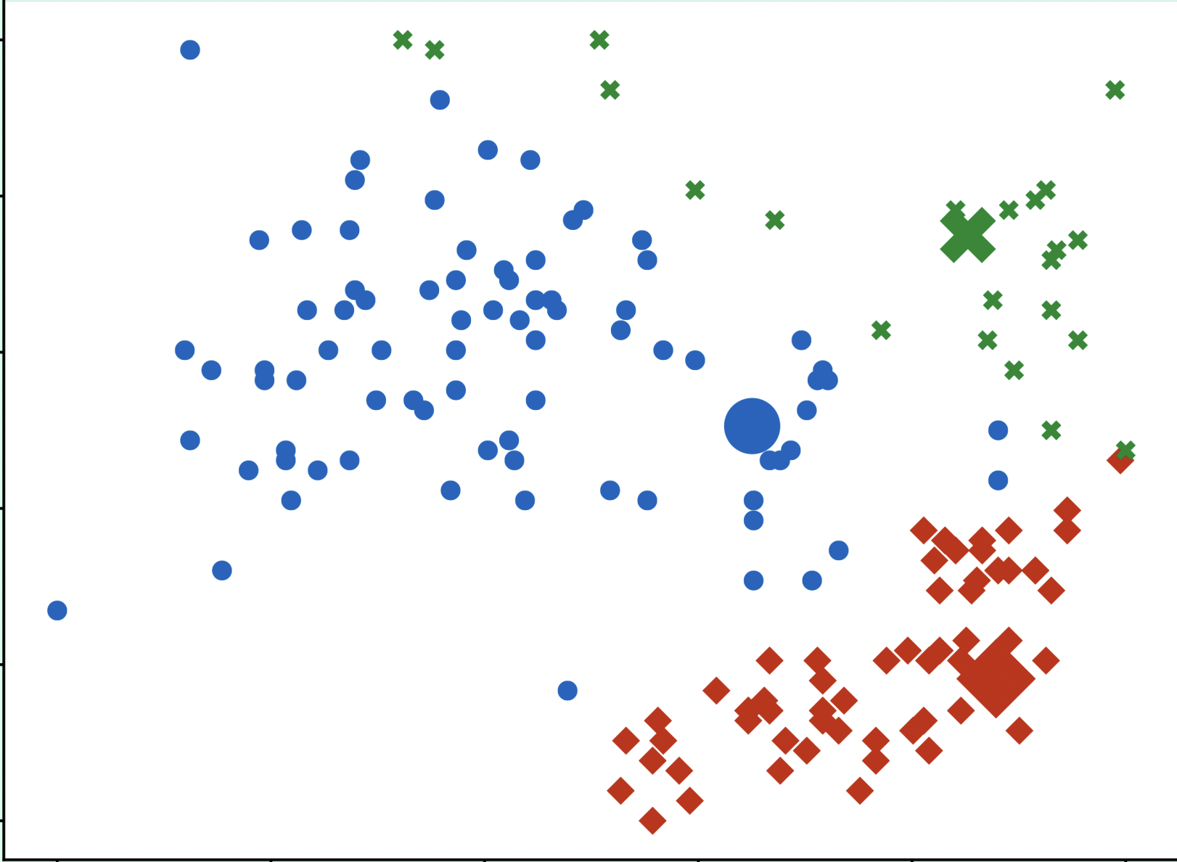
K-means Example with k = 3
2. Assign each data point to the closest mean.
Notes:
Each data point is assigned to the cluster of the nearest random seed.

Slide 10
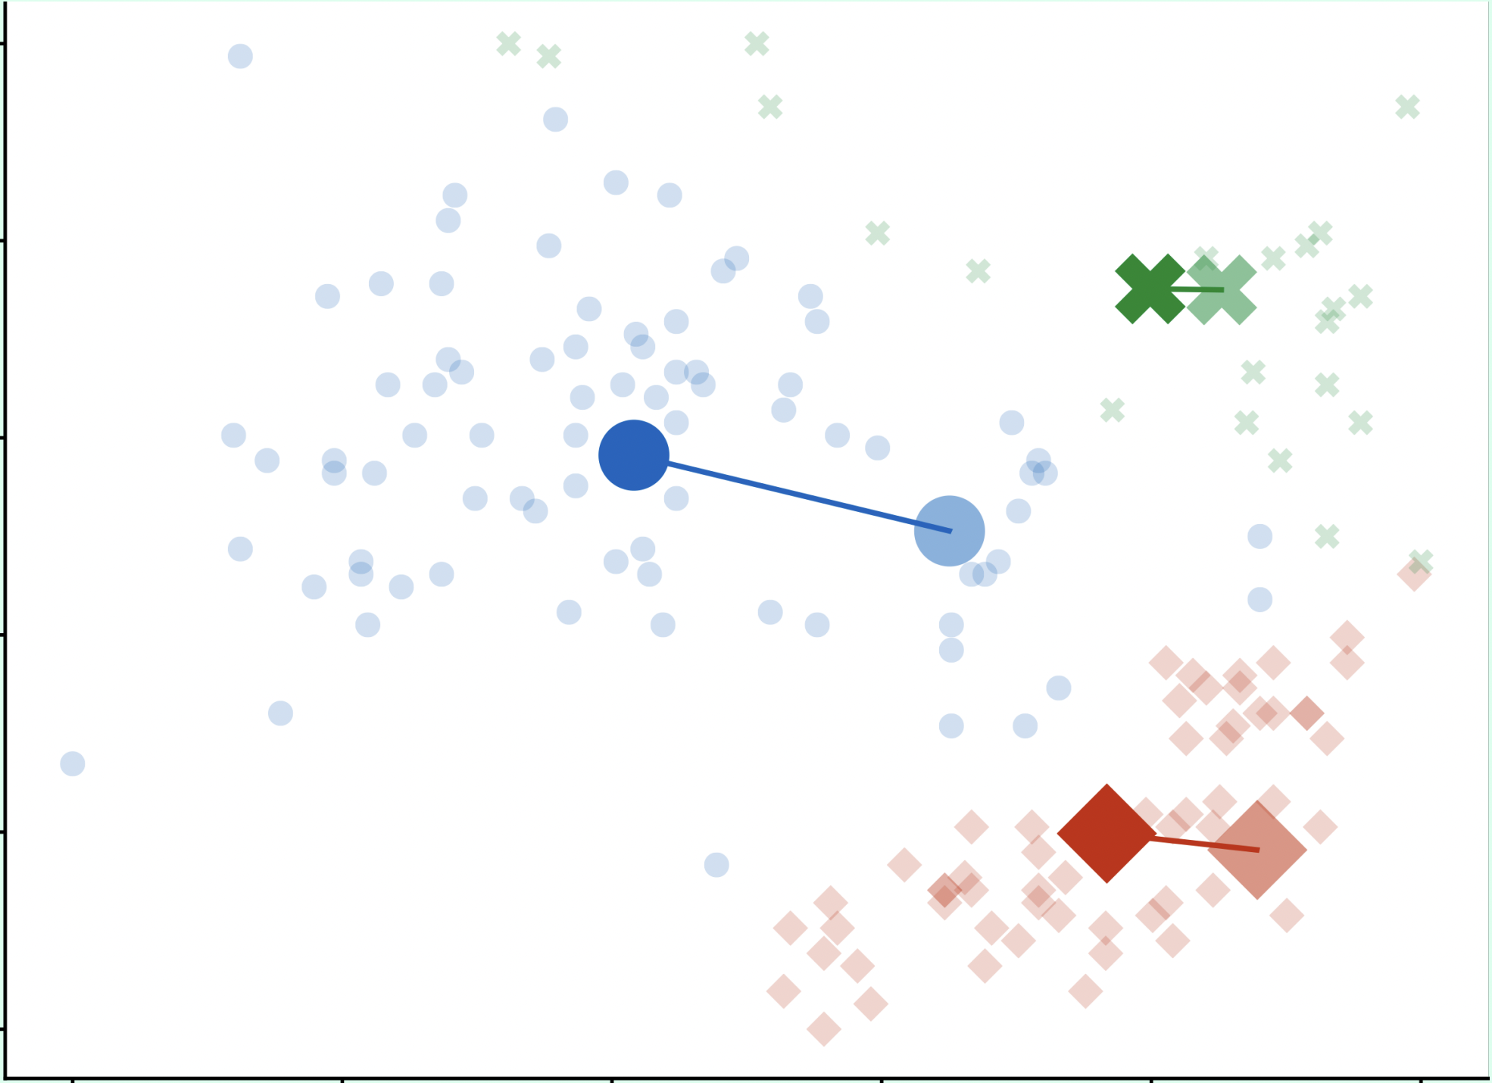
K-means Example with k = 3
3. Recompute the original mean of each cluster as the mean (average) of its data points.
Notes:
Next, the seed is changed to the average point in each cluster that was created in the second step.

Slide 11
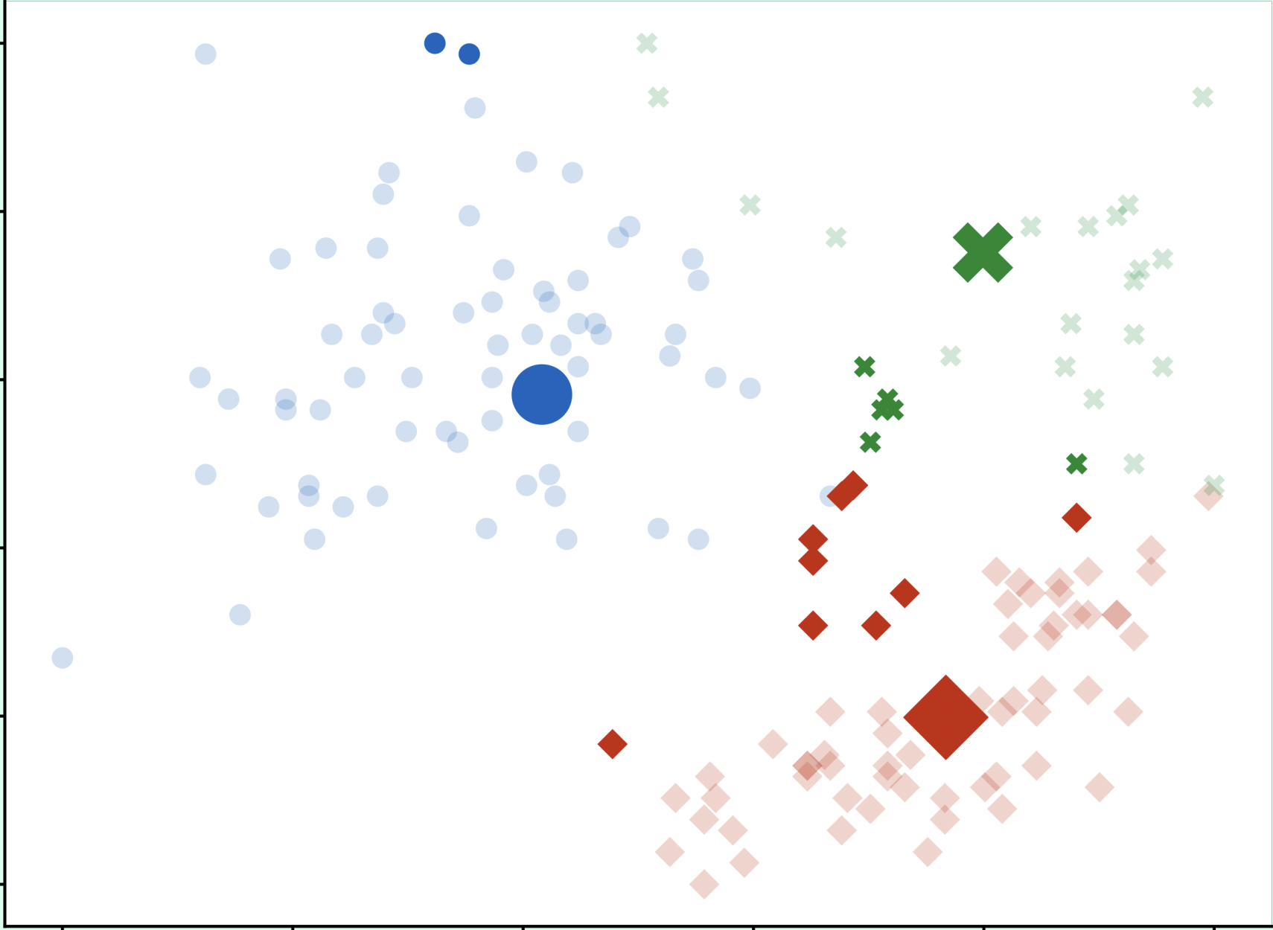
K-means Example with k = 3
4. Reassign each data point to the closest mean.
Notes:
Now, each data point is reassigned to the cluster of the mean that is closest to it.

Slide 12
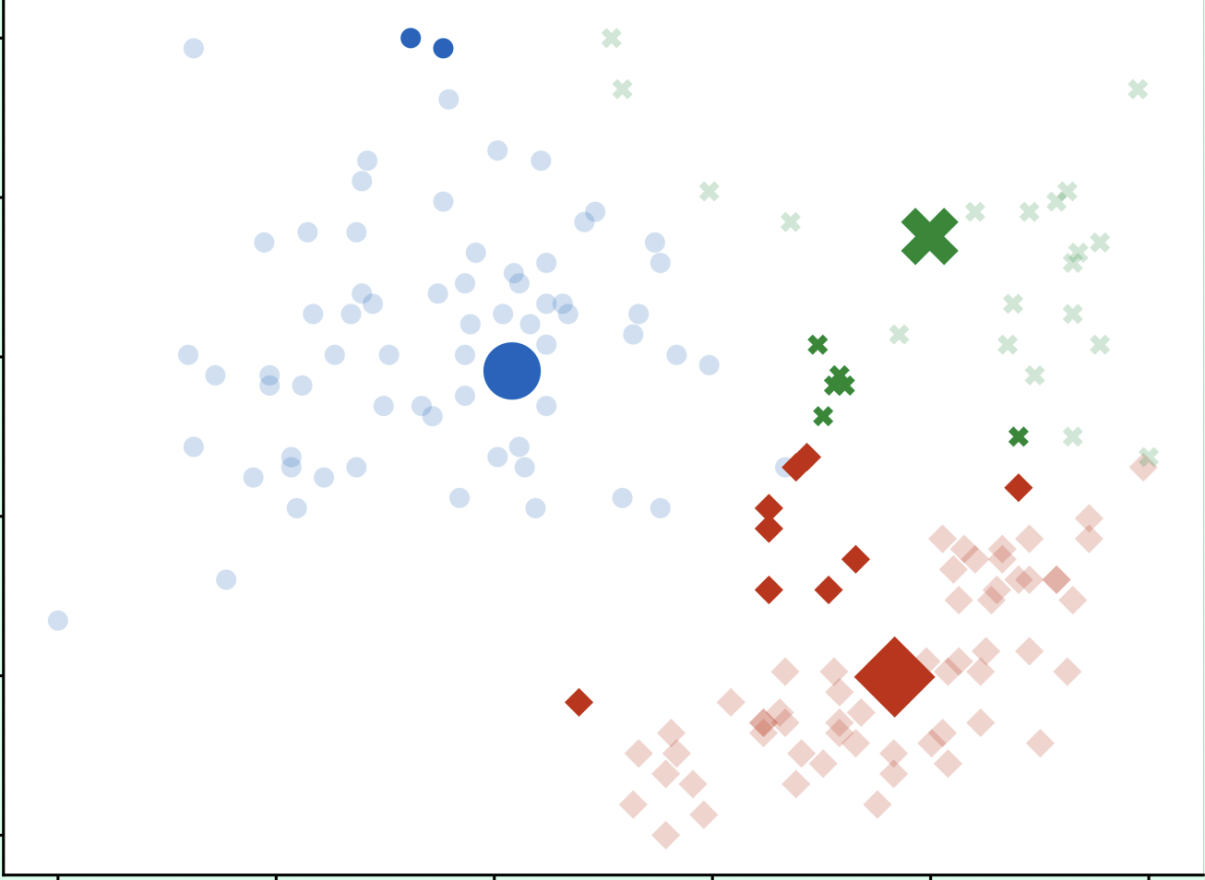
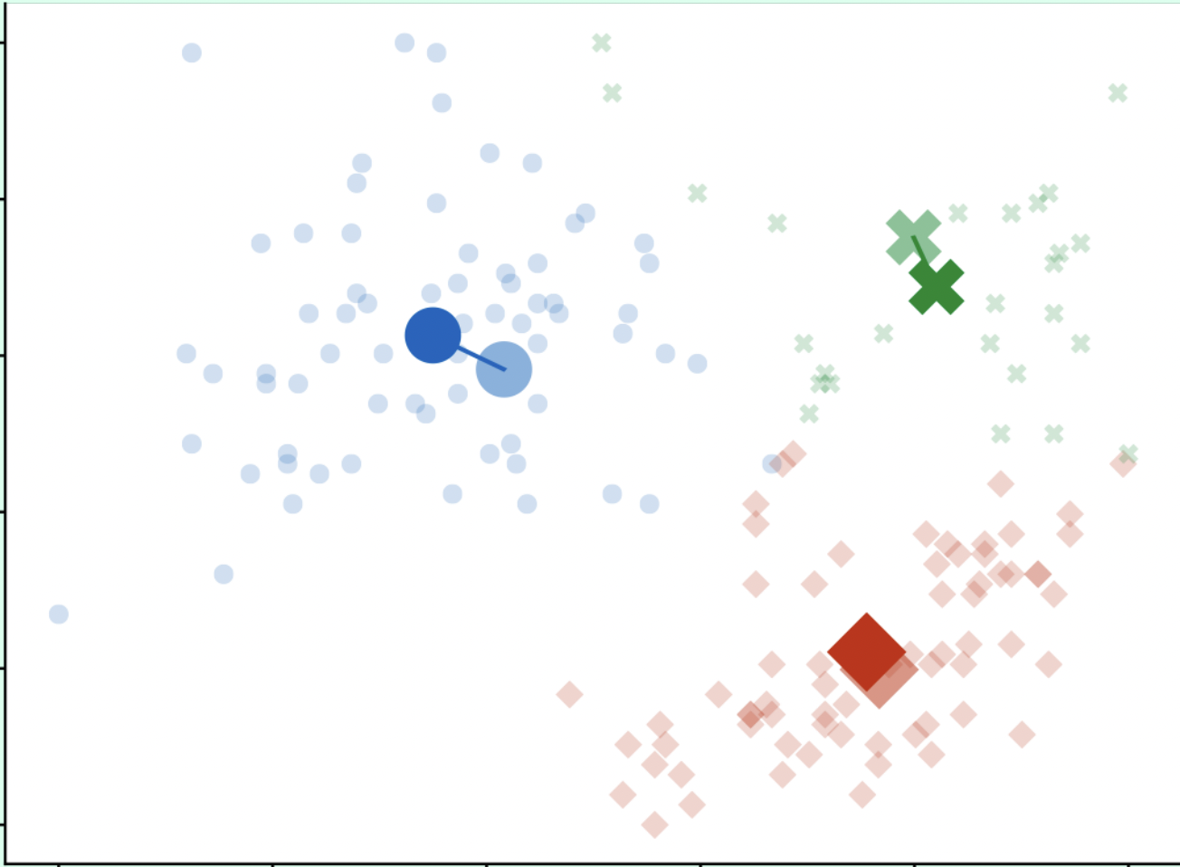
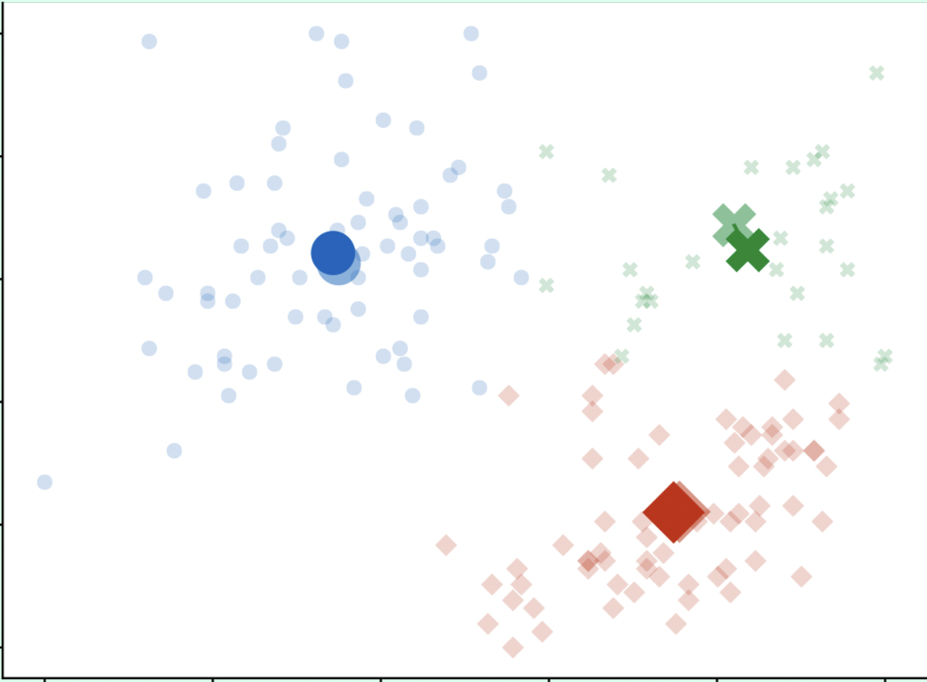
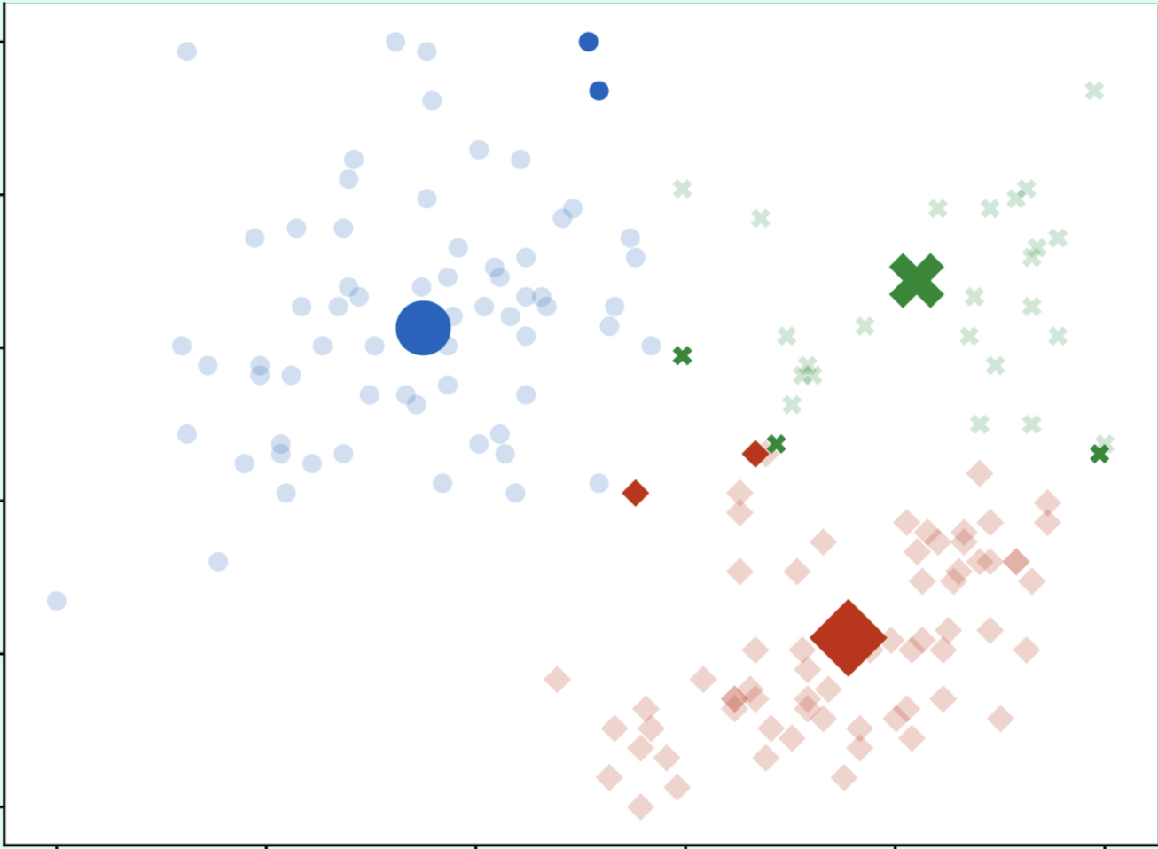
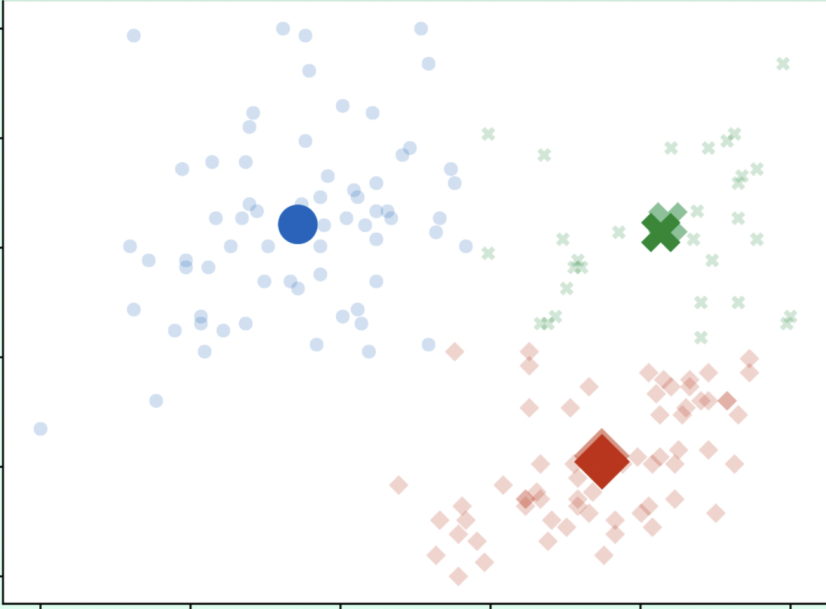
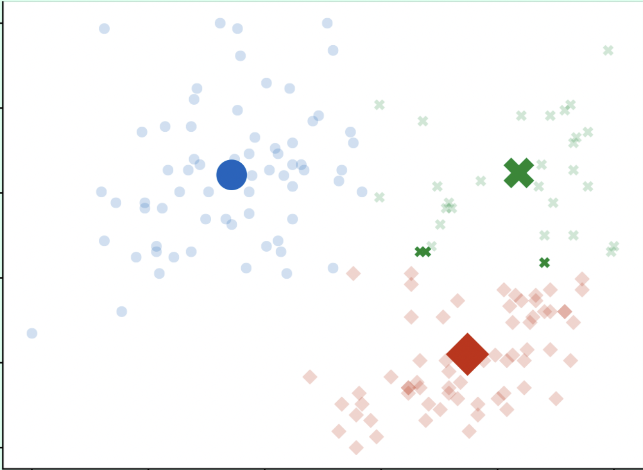
k-Means Multiple Iterations
Notes:
This cycle is iterated until the mean point of each cluster hardly moves or does not move. After every shift of the mean, the points are reassigned to the cluster of the nearest mean.

Slide 13
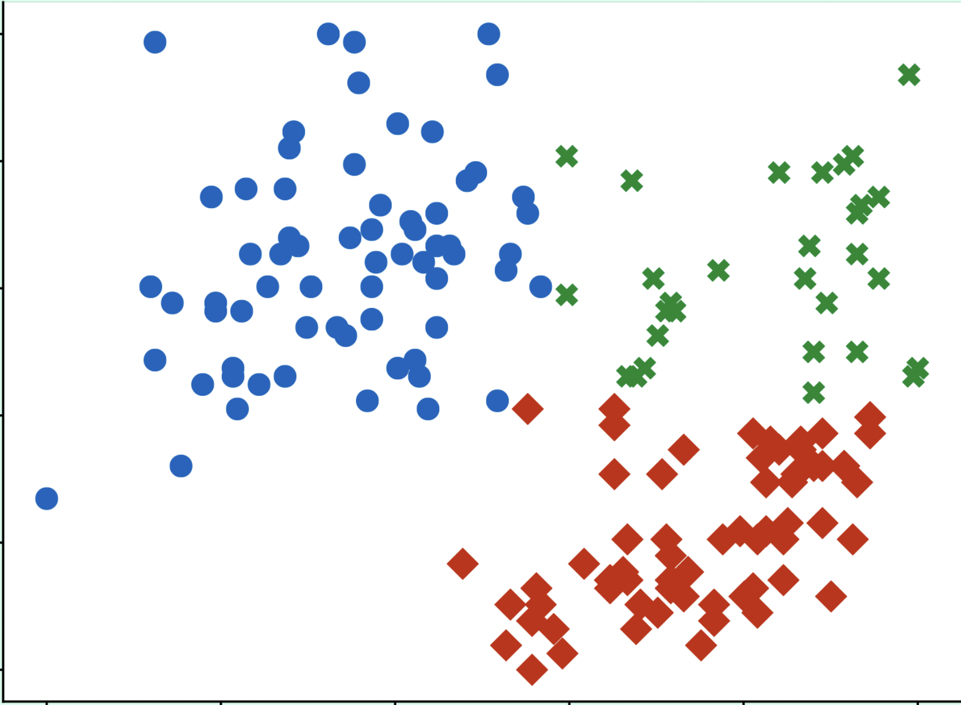
Comparison to Actual Labels
Bill depth (mm)
Bill depth (mm)
Bill length (mm)
Bill length (mm)
Actual labels
Estimated clusters
Notes:
This is the final comparison to the actual data.

Slide 14
Properties of k-means
K-means is a very fast algorithm
Works well with many examples
Also in high-dimensional spaces
Disadvantages:
K is an input parameter, estimating it is difficult
Gets stuck in local minima
Often no optimal cluster if found
Can not find non-convex clusters
Outliers might lead to problems
Notes:
K-means is a very fast algorithm that can work well in many different cases, including ones in high-dimensional space. The biggest issues are that k can be difficult to choose and that k may get stuck in local minima. That is, once a certain mean has been found, the cluster will not change again even if there may be a slightly better mean. Outliers can change the average value of a cluster significantly and may throw off the accuracy of a cluster.

Slide 15
Clustering Evaluation
Two scenarios:
External criterion: Actual labels are known
Evaluation can be similar to classification
Internal criterion: Actual labels are unknown
This is most often the case
Inter- & intra-cluster similarity is used.
Measured quality of clustering depends on similarity / distance measure used
Goal:
High intra-cluster similarity
Low inter-cluster similarity
INTRA-CLUSTER
INTER-CLUSTER
Notes:
In cases where the actual labels are known, as in the penguin example, evaluation can be performed similarly to classification. Each data point is either correctly or incorrectly clustered. However in practice there are often no correct labels for the clusters and the number of clusters might even be unspecified. In this case, we measure the similarity of points within clusters as compared to the similarity of points in different clusters.

Slide 16
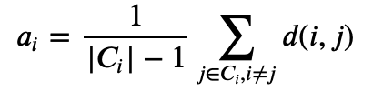
Silhouette Coefficient
Silhouette coefficient is a measure between -1 and 1 to evaluate clusters.
High value: point is well clustered
Low value: point is poorly clustered
Mean distance between a point i and all other points of the same cluster (intra-cluster similarity).
d(i,j) can be any distance measure
function
Notes:
Silhouette coefficient is a metric for comparing cluster similarity. The goal is to maximise the silhouette coefficient, meaning that data points within a cluster are similar.

Slide 17
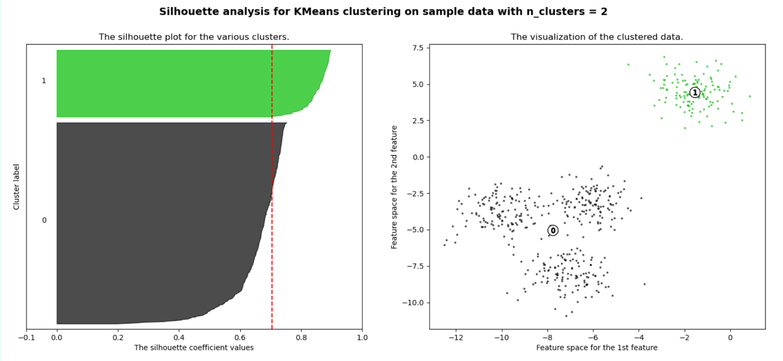
Silhouette Coefficient with k-Means, k=2
Notes:
Let’s look at one example. The data does not change, but the k-value does. The calculated silhouette coefficient is indicative of which k is the best. The red dotted line indicates the average silhouette coefficient of all the different clusters.
https://scikit-learn.org/stable/auto_examples/cluster/plot_kmeans_silhouette_analysis.html

Slide 18
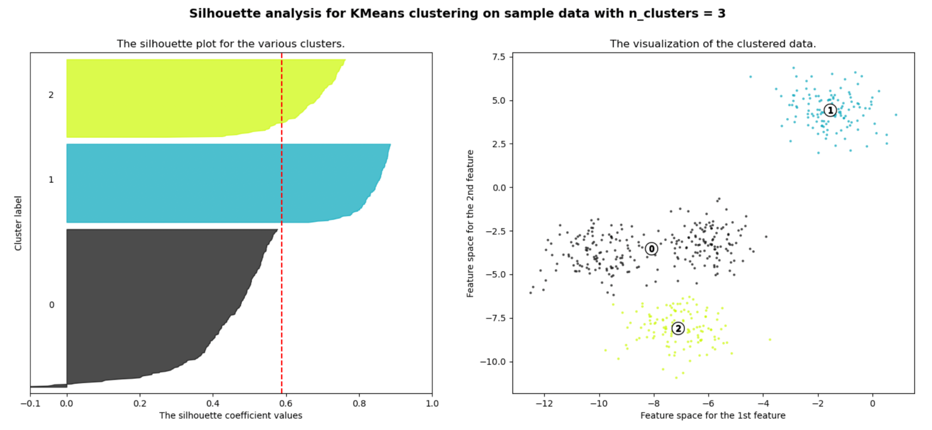
Silhouette Coefficient with k-Means, k=3
Notes:
https://scikit-learn.org/stable/auto_examples/cluster/plot_kmeans_silhouette_analysis.html

Slide 19
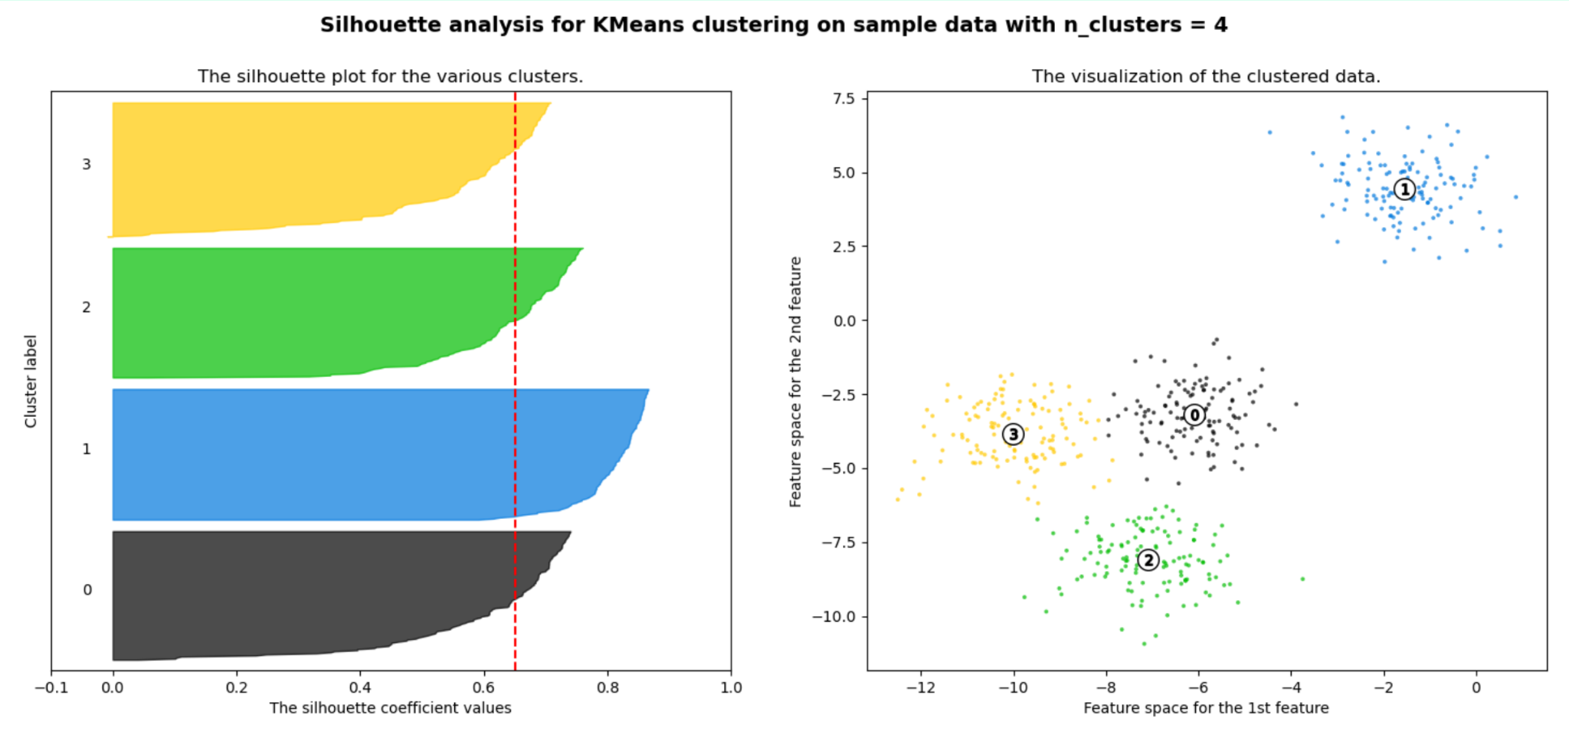
Silhouette Coefficient with k-Means, k=4
Notes:
https://scikit-learn.org/stable/auto_examples/cluster/plot_kmeans_silhouette_analysis.html

Slide 20
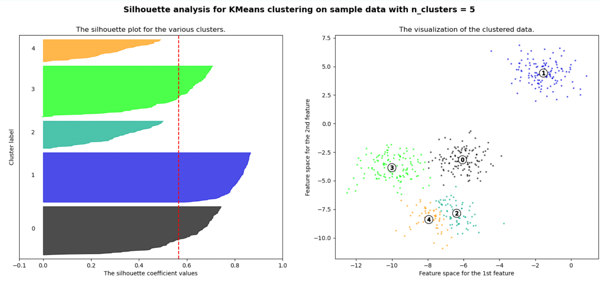
Silhouette Coefficient with k-Means, k=5
Notes:
https://scikit-learn.org/stable/auto_examples/cluster/plot_kmeans_silhouette_analysis.html

Slide 21
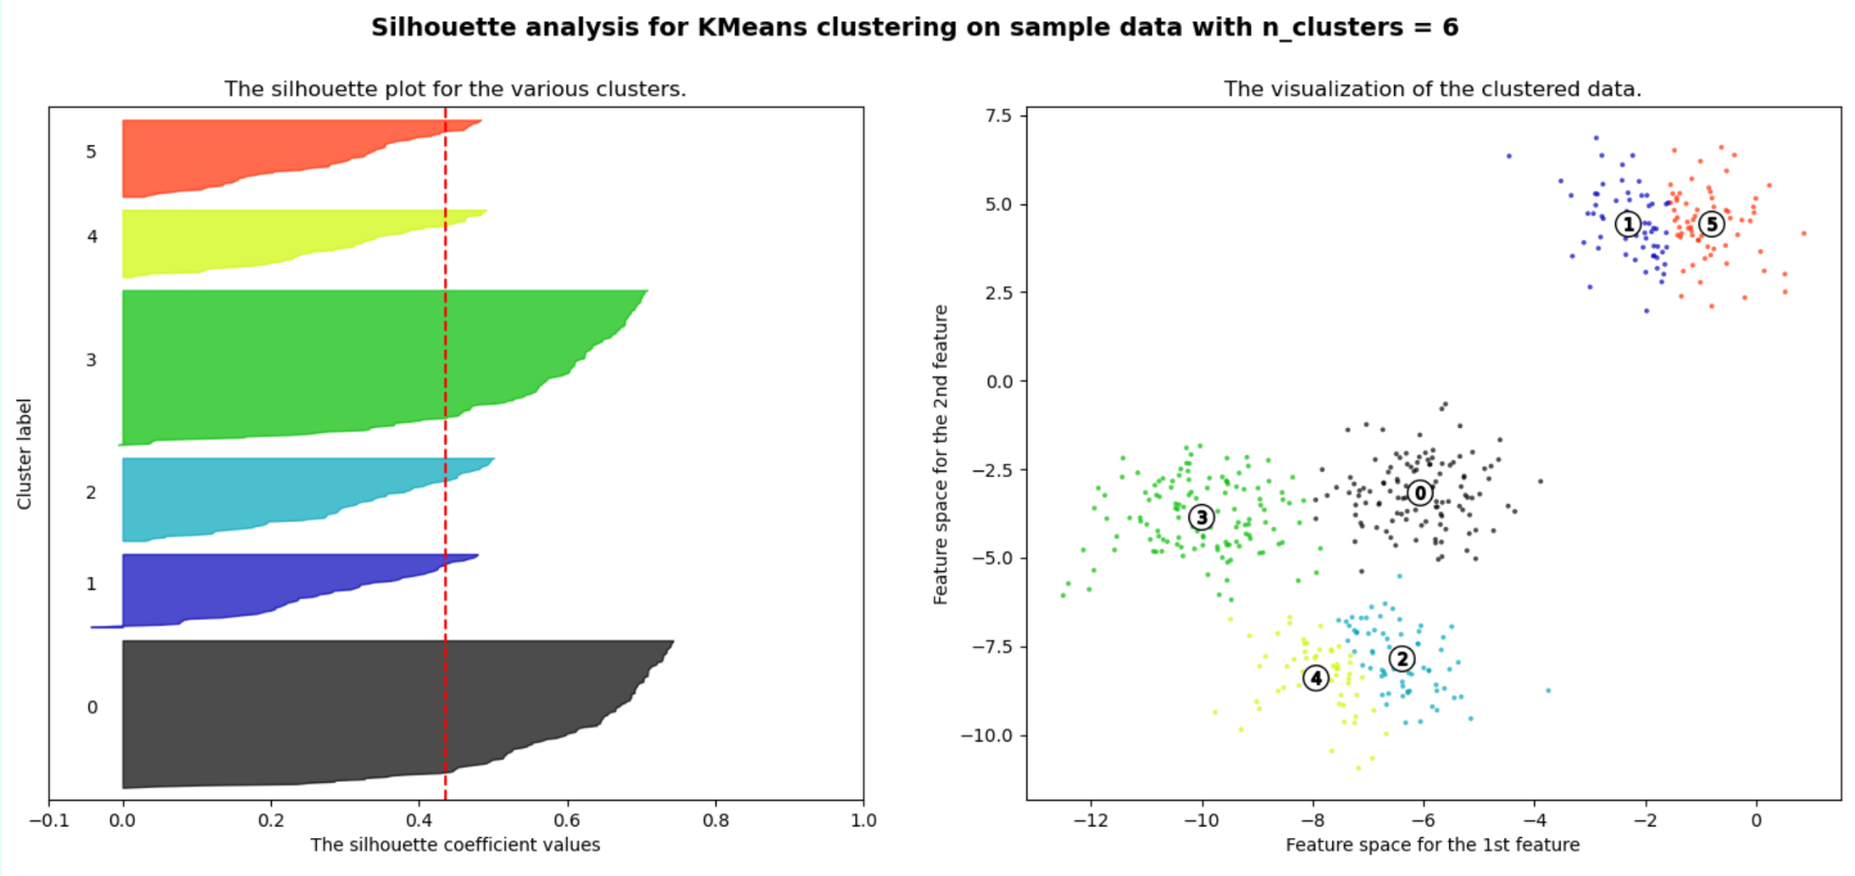
Silhouette Coefficient with k-Means, k=6
Notes:
https://scikit-learn.org/stable/auto_examples/cluster/plot_kmeans_silhouette_analysis.html

Slide 22
Choosing k with Silhouette Coefficient
Average silhouette scores for different k:
k = 2 | 0.70
k = 3 | 0.59
k = 4 | 0.65
k = 5 | 0.57
k = 6 | 0.42
Still difficult to choose… It depends on what size clusters are we interested in!
best options
Model selection for clustering depends completely on what you’re doing with the clusters.
Notes:
Choosing k with the highest silhouette coefficient is not always the best choice. Although k = 2 had the best performance, the size of the two clusters were very different, whereas the cluster in k = 4 were of very similar size, which we may prefer depending on the goal.

Slide 23
Part 3: Artificial Neural Networks
Notes:
Now we will switch gears and have an introduction to neural networks.

Slide 24
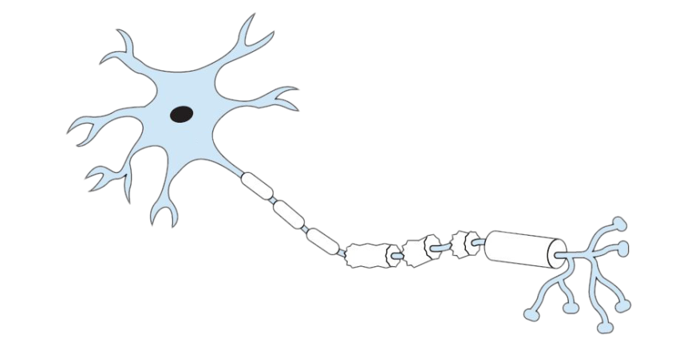
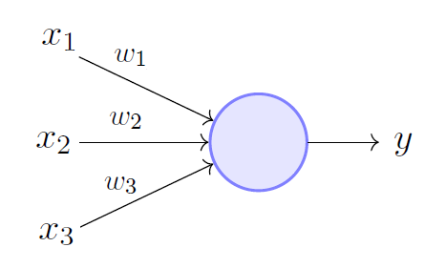
The Perceptron
b
1
Human neuron
Perceptron (1957)
y = w₁x₁ + w₂x₂ + b
Notes:
The artificial neural network is inspired by and designed similarly to the human brain. Human neurons inspired the first perceptron created in 1957, which is simply several weights w and a bias b term as input features leading to some output. Note that this is just a visualisation of a mathematical function which can be used for classification or regression tasks. For example, if y is > 0, then an instance is positive, and otherwise it is negative.

Slide 25
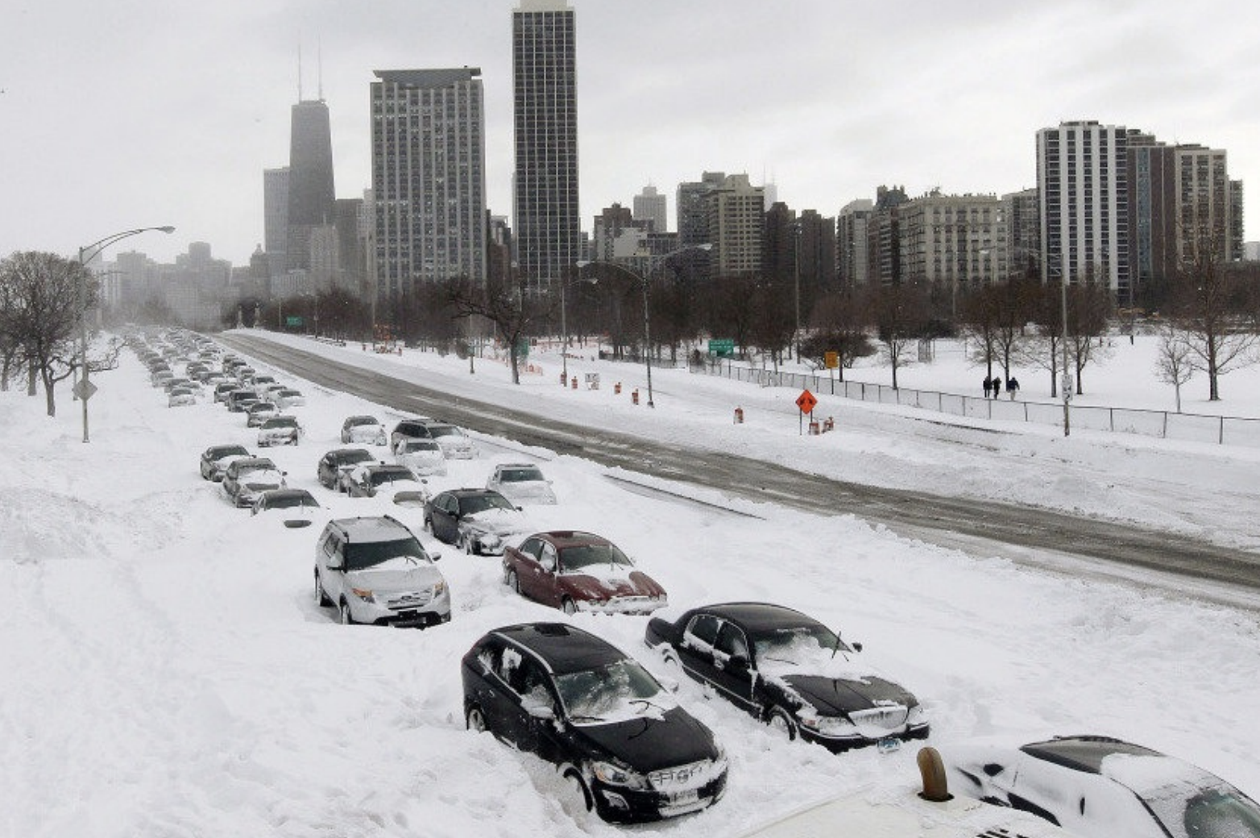
1990s Neural Net Winter
Notes:
In the 1990s computers were too slow to use neural networks in practice. Few research was dedicated to the field as a result and it was more a theoretical exercise. In the last 10 to 15 years the increase in computing power has led to its promise.

Slide 26
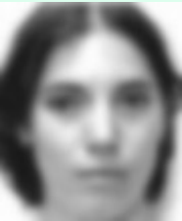
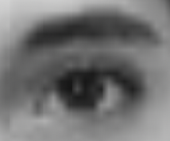
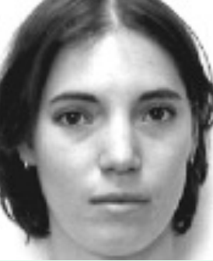
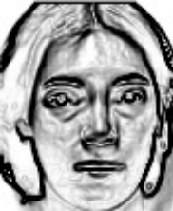
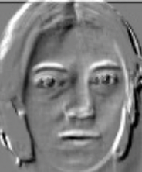


The Promise of Depth
“long hair”
“eyes”
“woman”
“nose”
low level features
medium level
high level
Notes:
Today we use very very deep neural networks, which simply means there are many layers, which we refer to as deep learning. These networks can capture much more complex features than other methods. For example, an image is dissected into its pixels, which each have a complex set of features that can lead to semantic detection of objects.

Slide 27
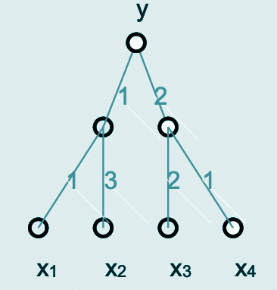
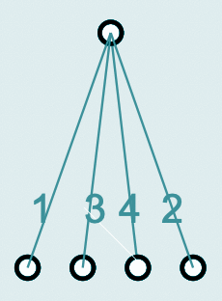
Composing Neurons
Problem: perceptrons will always remain linear.
y = 1(1x₁ + 3x₂) + 2(2x₃ + 1x₄)
y = 1x₁ + 3x₂ + 4x₃ + 2x₄
Notes:
The problem with building deep networks with perceptrons is that these functions will always be linear. Even if we add many layers and end up with a more complex function, we can simplify this and end up with a simple network again.

Slide 28
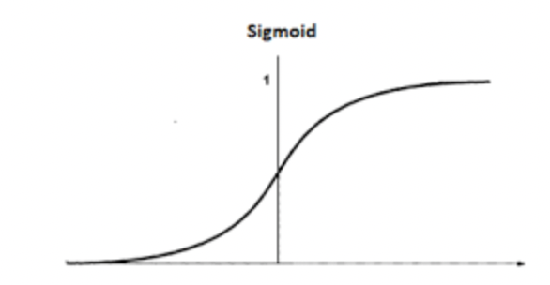
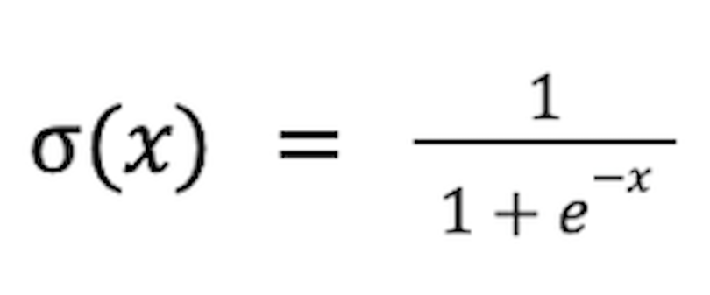
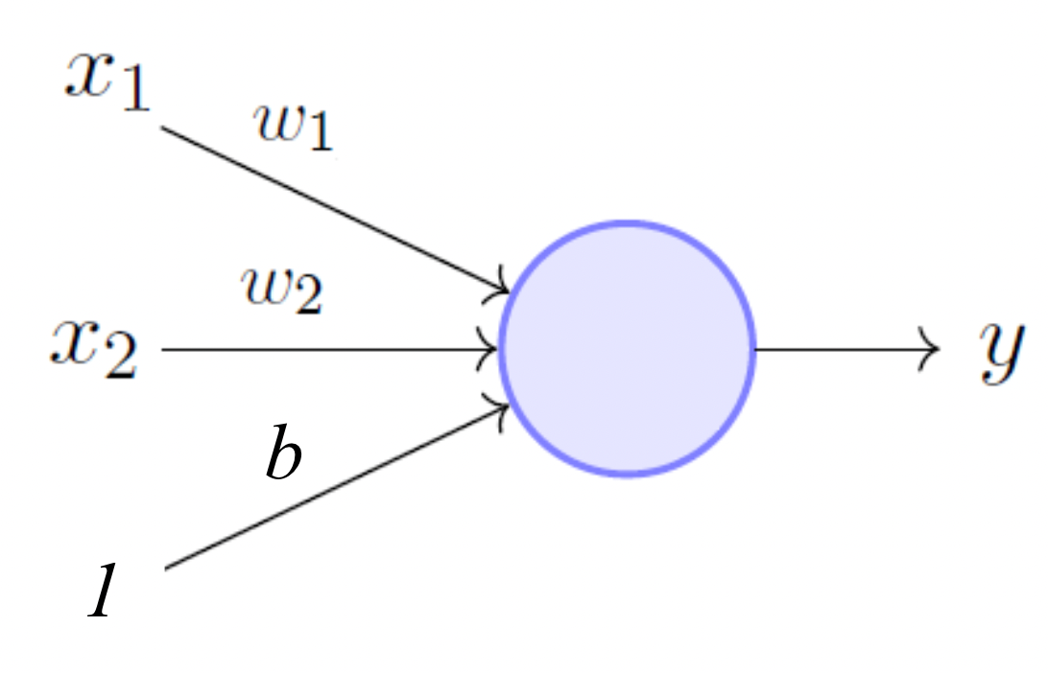
Non-linearities: Activation Functions
Sigmoid σ is an activation function with a characteristic S curve.
Applied to the function in order to make it nonlinear.
y = σ(w₁x₁ + w₂x₂ + b)
Notes:
The solution to this problem is activation functions, or nonlinearities, which are other functions added to the nodes of a neural network. For example, the sigmoid function with its characteristic S shape changes each value to be between 0 and 1. You should know what an activation function is, but the mathematical details are not important for now.

Slide 29
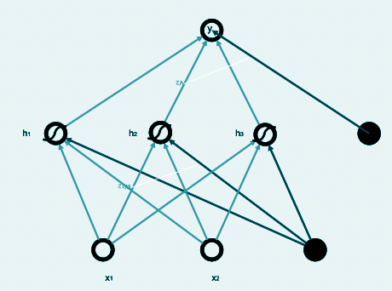
Feedforward Networks
In a feedforward network, weights and biases only flow forward in one direction.
output layer
Sigmoid function
hidden layer
Also called a multilayer perceptron (MLP).
input layer
(features)
Notes:
A feedforward network is a neural network in which the information only flows in one direction. Starting from the bottom of this diagram, the input layer is fed to a hidden layer and gives one output. Normally, neural networks have many hidden layers. The more hidden layers, the deeper the network. This is also called a multilayer perceptron.

Slide 30
Regression
numerical value
y
linear regression
h
feature expansion
x
Notes:
We could, for example, use a network for regression…

Slide 31
Binary Classification
p(C=Pos|x)
y
probability
h
feature expansion
x
Notes:
…binary classification where a positive result means membership of a certain class. We use the sigmoid function to create a probability between 0 and 1.

Slide 32
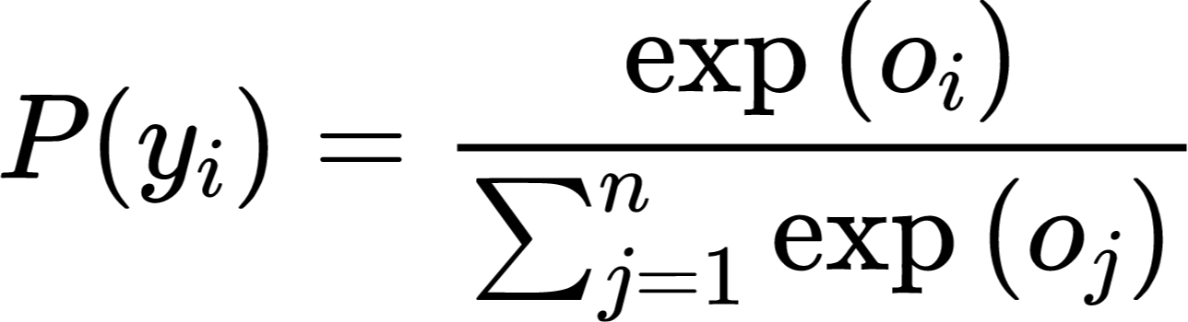
Multiclass Classification
Softmax is an activation function for multiclass classification, which gives a probability of an instance belonging to each class.
p(C=Class|x)
0.1
0.6
0.3
y
multiple probabilities
h
feature expansion
x
Notes:
…or multiclass classification where there are multiple nodes in the output layer. For multiclass classification there is a softmax activation function which assigns a probability to each class, classifying an instance as the class with the highest probability (you don’t need to know the math).

Slide 33
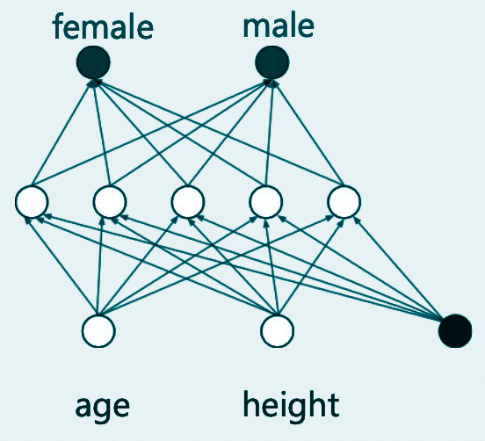
Feedforward Network Example
output layer
hidden layer
input layer
(features)
Notes:
In this example, we are using age and height as the two features for a binary classification problem with two output nodes.

Slide 34
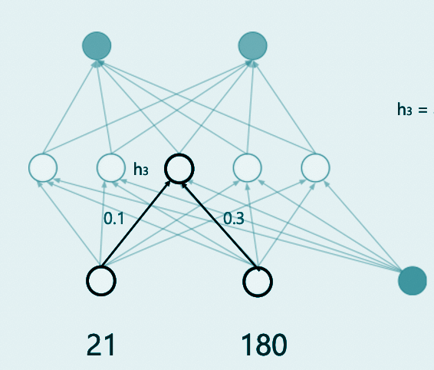
Feedforward Network Example
h₃ = σ(0.1⋅21 + 0.3⋅180)
Notes:
In this case the instance has an age of 21 and a height of 180, which leads to weights 0.1 and 0.3 in this example.

Slide 35
Backpropagation
Backpropagation is making a backward pass to adjust a network’s parameters.
1
2
0.3
0.6
err:0.7
err:-0.6
31
165
age
height
Notes:
In this example the instance has an age of 31 and a height of 165 cm. When we want to learn a neural network, we find the output values and find the error by comparing to the actual value. We can build an error function and use it to adjust the weights through backpropagation and adjust the model. You will learn all about the specifics in the course Machine Learning.

Slide 36
Neural Network Methodology
Collect examples of input and output.
e.g. 5000 trees’ height, age, and health
Get a loss function.
Work out the gradient of the loss w.r.t the weights
Use (stochastic) gradient descent to improve the weights bit by bit.
Notes:
Neural network methodology, like other methods, always start by collecting enough data to train the model. Then we work out a loss function in order to adjust the parameters of the network and decrease the error rate.

Slide 37
Part 4: Deep Learning & Transformers

Slide 38
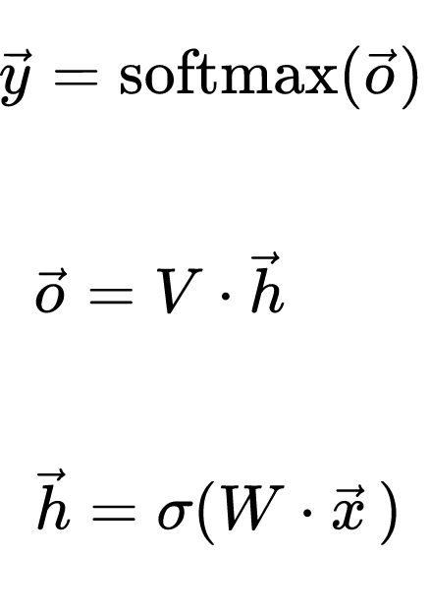
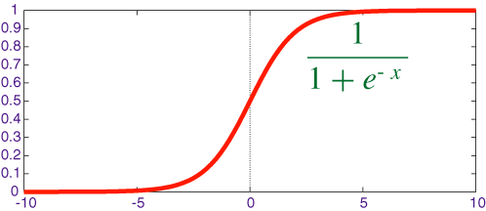
Multiclass, Multilayer Perceptron
creates probabilities
Output
y
V
h
linear transformation
W
bias
(always 1)
x
nonlinear “activation”
σ =
Input
Notes:
Every layer in the network is described by an equation.

Slide 39
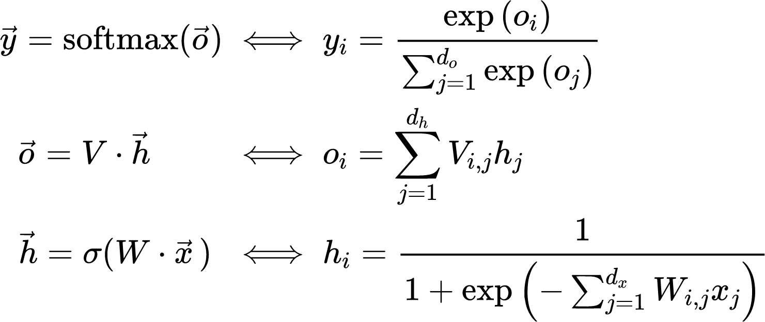
Multiclass, Multilayer Perceptron
Vector
notation
creates probabilities
linear transformation
nonlinear “activation”
Notes:
It’s convenient to write these equations with vector notation.

Slide 40
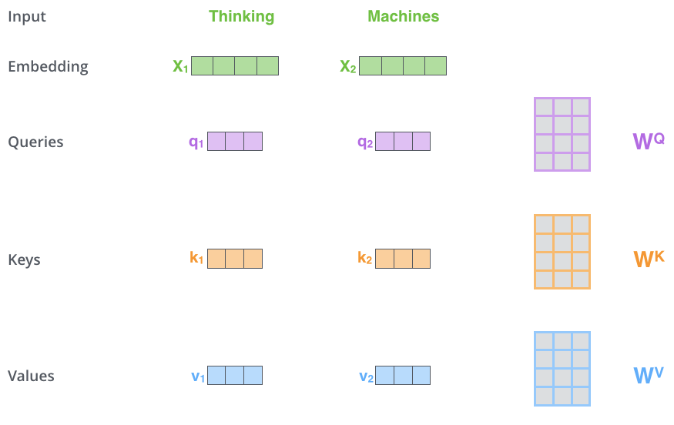
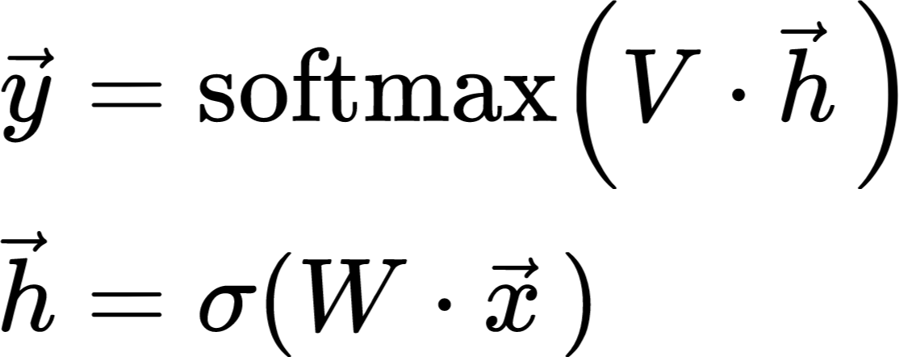
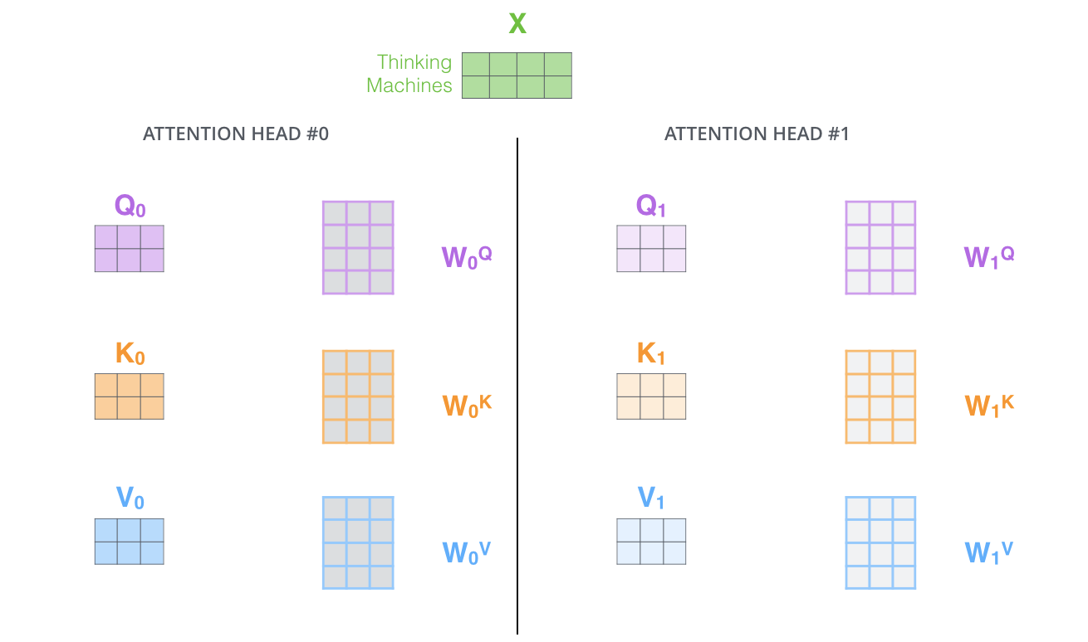
Multiclass, Multilayer Perceptron
y
V
h
W
x
Equation
Network
Shapes
Notes:
The network can be viewed in different forms: equations, a network visualization, or using the shapes of its vectors and matrices.

Slide 41
Multiclass, Multilayer Perceptron
y
V
h
“Feed Forward”
W
x
Equation
“Architecture”
Notes:
The network visualization is often simplified into an architecture diagram, which shows the different types of layers. Here, we have two feed-forward layers.

Slide 42
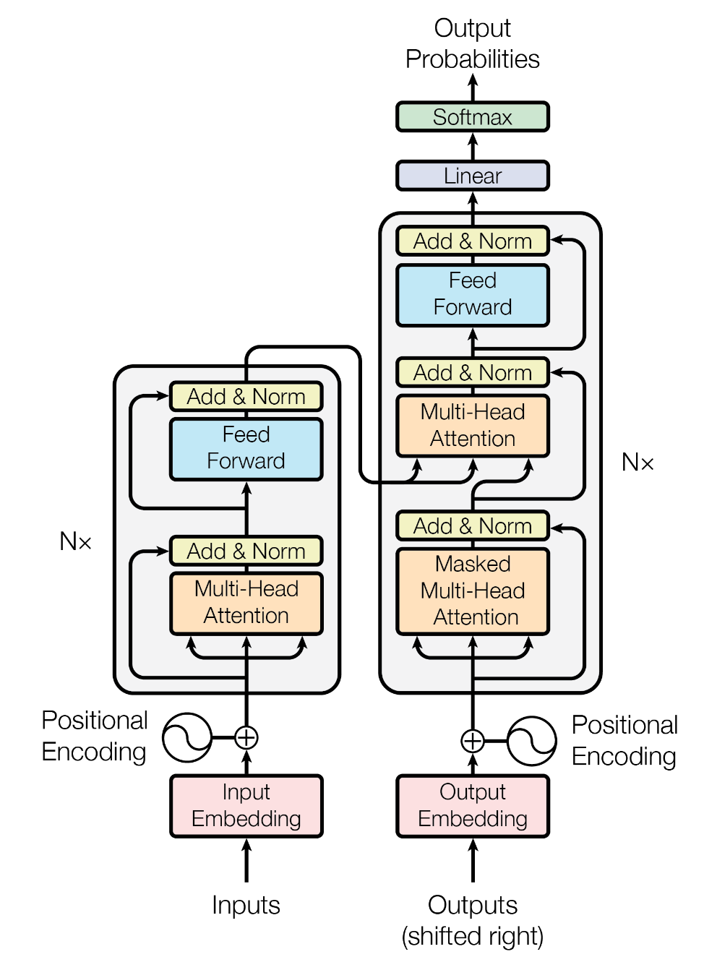
Transformer Architecture
Looks complicated, but…
Similar components repeated many times
Everything is just Calculus
Still trained with Stochastic Gradient Descent!
because the loss (=error) function has a nice derivative
Trained on next-word prediction:
😵‍💫
The dog runs …
<s> The dog runs
Notes:
One recently popular architecture is called the Transformer. Even though it may look complex, you might recognize some parts of it already: the Feed-forward layers, the linear transformation, and the softmax output. Every layer is an equation that has a derivative, so the whole network can be trained by stochastic gradient descent. Often, this model is trained on next-word prediction in text, making it a language model.

Slide 43
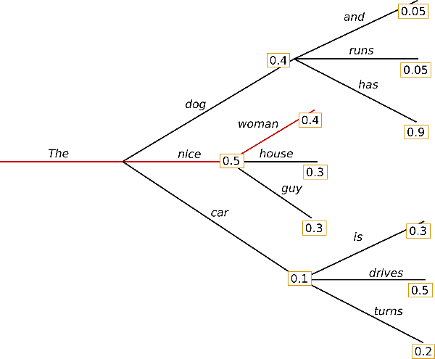
Transformer Beam Search
When using the trained model, word probabilities are predicted one-by-one to form a sequence.
The algorithm looks for the top-k sequences with high total probability using Local Beam Search.
Not the most probable sequence is chosen, but instead one is (semi-) randomly chosen from the top-k.
The dog runs …
<s> The dog runs

Slide 44


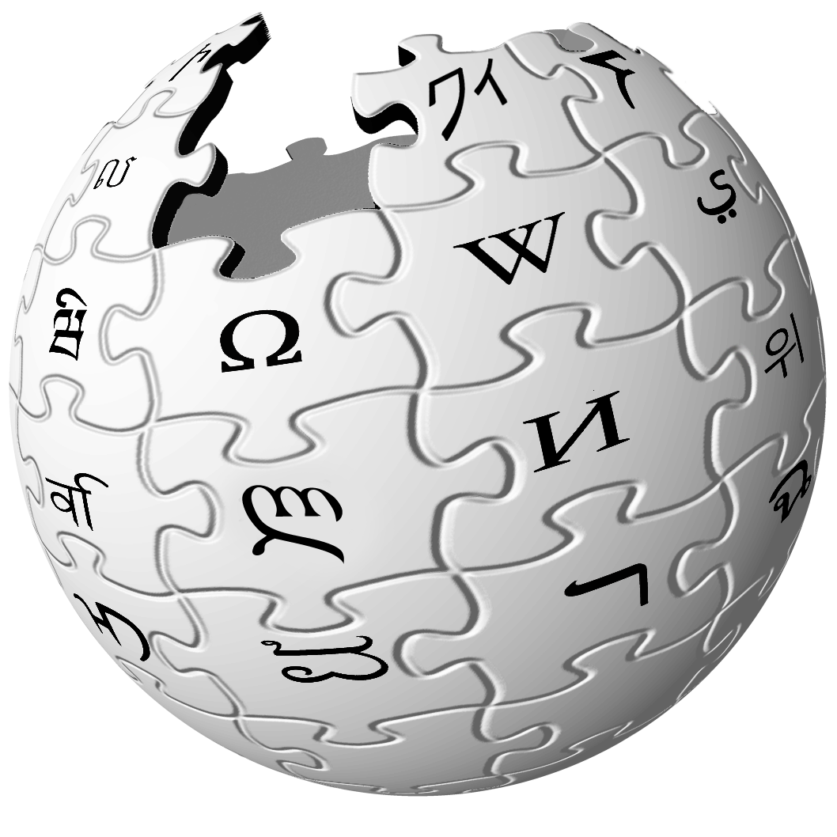
Generative Pre-trained Transformer (GPT) → ChatGPT
Step 1: Pre-training
Step 2: Fine-Tuning
Unsupervised
High-quality text (~ 8 terabytes for GPT3) (≈ Library of Congress ≈ 10 million books)
Supervised
Conversations + Human Feedback
🧑‍🏫
Notes:
The famous ChatGPT (Generative Pre-trained Transformer) is trained with two steps: first unsupervised, then supervised.

Slide 45
Intelligent Systems Framework
Efficient, simple, correct, well-understood, generic | Find best decision based on experience. | Weeks 6 & 7
 | Find best decision with knowledge & reason. | Weeks 3, 4, 5
 | Find best decision in multiple agent setting. | Weeks 1 & 2
 | Find best decision with heuristics.
 | Systematically find all possible solutions.
Notes:
Progress in the intelligent systems framework.

Slide 46
Summary
Take Home Message
Clustering is an unsupervised method of grouping data points, such as the k-means algorithms. K-means finds clusters by iteratively reassigning the mean for k clusters. It can be evaluated with the silhouette coefficient. The selection of the best model here depends on what you use it for.
Neural Networks use weights and biases as parameters to make predictions. They can be made nonlinear with activation functions.
Deep Neural Networks are simply very complicated differentiable functions. Their architecture is often visualized in a diagram.
The Generative Pre-trained Transformer is trained to generate words using lots of unsupervised pre-training and supervised fine-tuning.
Notes:
Thank you for your attention and have a great day.

